Slide 1
Send JSON-format student data from node.js server via NGRok
19673 Jisen Fang

Slide 2
Table of contents
Concept
student_info.js
node.js server
Localhost result
Set up NGRok
Start NGRok
Result

Slide 3
Concept
JSON: JSON stands for JavaScript Object Notation. It is a lightweight format for storing and transporting data that often used in data sent from a server to a web page.
Node.js: Node.js is a back-end JavaScript runtime environment that uses JavaScript on the server.
NGRok: Ngrok could map your local private address to a public address in this project.

Slide 4
student_info.js
const server = http.createServer((req, res) => {
if (req.url.startsWith('/api/score?student_id=')) {
const studentId = parseInt(req.url.split('=')[1]);
const student = students.find(student => student.id === studentId);
if (student) {
res.writeHead(200, { 'Content-Type': 'application/json' });
res.end(JSON.stringify(student));
} else {
res.writeHead(404, { 'Content-Type': 'text/plain' });
res.end('Student not found');
}
} else {
res.writeHead(404, { 'Content-Type': 'text/plain' });
res.end('Invalid URL');
}
});
const PORT = 8000;
server.listen(PORT, () => {
console.log(`Server is running on port ${PORT}`);
});
const http = require('http');
const students = [
{ id: 11111, name: 'Bruce Lee', score: 84 },
{ id: 22222, name: 'Jackie Chen', score: 93 },
{ id: 33333, name: 'Jet Li', score: 88 },
];

Slide 5
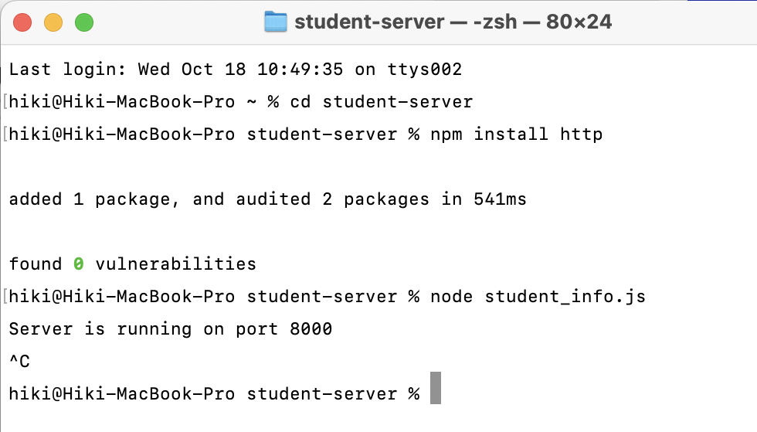
node.js server
Copy the student_info.js to the directory
Install required dependencies
npm install http
Run the server
node student_info.js
Create a student-server directory
mkdir student-server
cd student-server
Initialize a Node.js Project
npm init -y

Slide 6
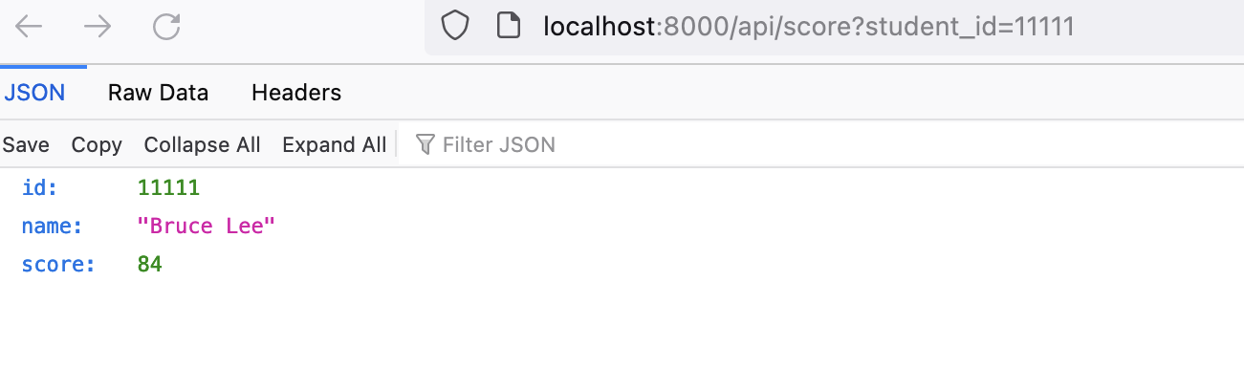
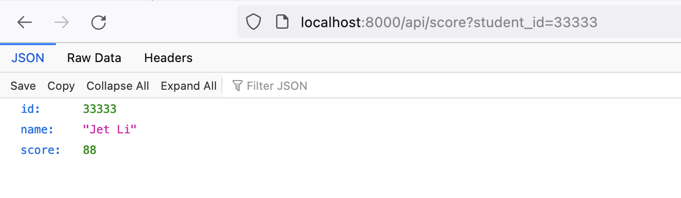
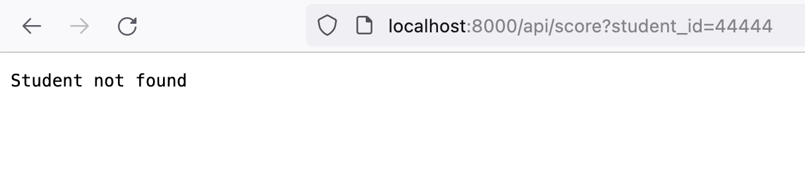
localhost

Slide 7
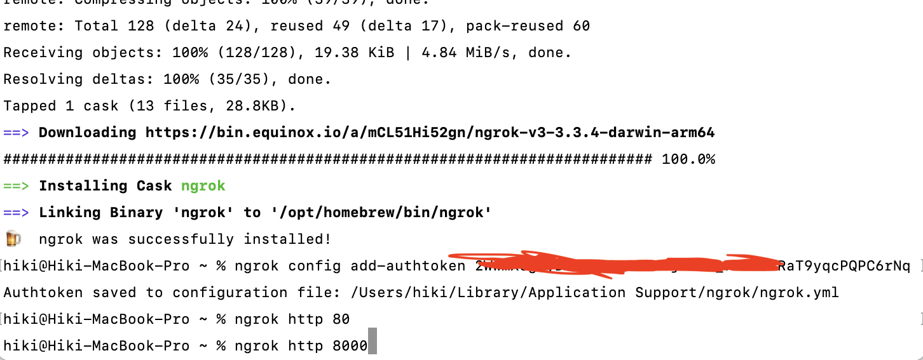
Set up NGRok
Install NGRok via Homebrew
brew install ngrok/ngrok/ngrok
Add authtoken, you need to sign up a account for authtoken
ngrok config add-authtoken <token>

Slide 8
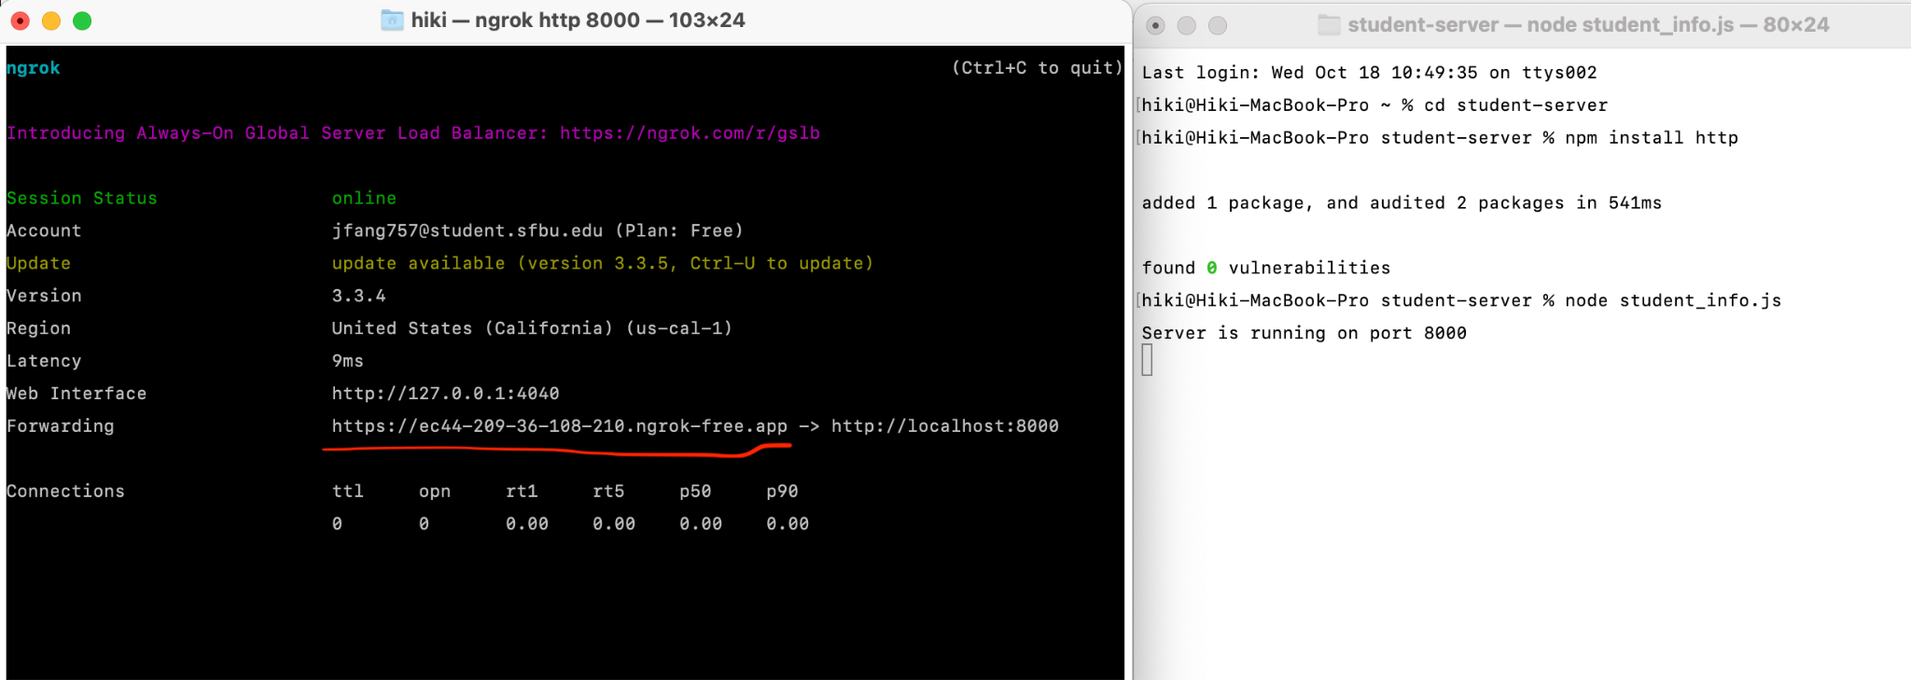
Start NGRok
Start a tunnel
ngrok http 8000
Use the address above the red line to access server
Ex: http://ec44-209-36-108-210.ngrok-free.app/api/score?student_id=11111

Slide 9
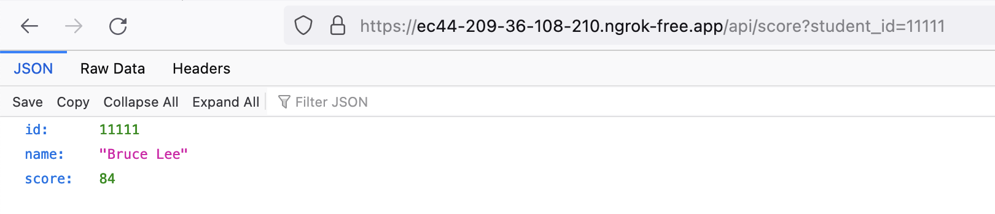
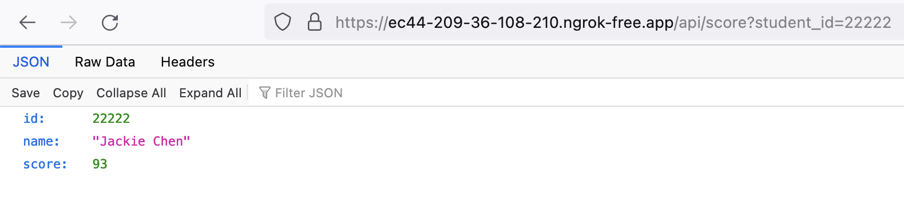
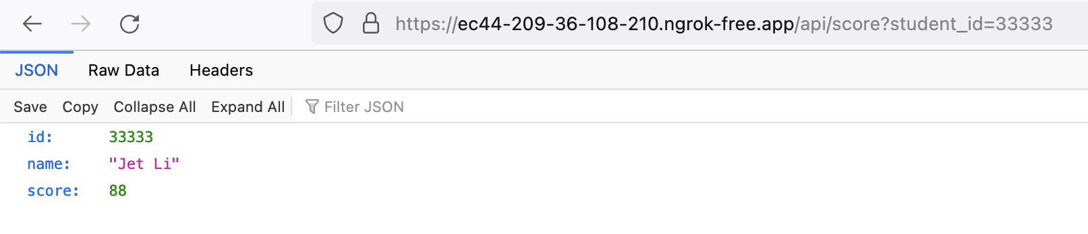
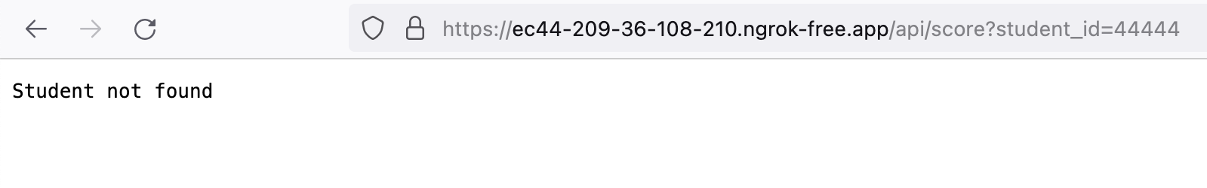
Result

